Slide 1
Fuzzy Logic
“The essence of fuzzy logic is that everything is a matter of degree”
Notes:
Idea: How about doing a fuzzy logic implementation of the flocking algorithm?

Slide 2
Fuzzy Logic
1937, Max Black published a paper called:
“Vagueness: an exercise in logical analysis”.
In this paper, he argued that a continuum implies degrees.
Imagine, he said, a line of countless “chairs”. At one end is a Chippendale. Next to it is a near-Chippendale which is indistinguishable from the first chair.
Succeeding “chairs” are less and less chair-like, until the line ends with a log.
When does a chair become a log?
He stated that if a continuum is discrete, a number can be allocated to each element.
He accepted vagueness as a matter of probability.

Slide 3
Fuzzy Logic
In 1965 Lotfi Zadeh, published his famous paper “Fuzzy sets”.
He extended earlier work on possibility theory into a formal system of mathematical logic, and introduced a new concept for applying natural language terms.
This new logic for representing and manipulating fuzzy terms was called fuzzy logic.
Fuzzy logic is a set of mathematical principles for knowledge representation based on degrees of membership.

Slide 4
Boolean Logic
Standard Boolean Logic has only two states
True
False
This maps nicely to computers with binary logic gates
0 - Off
1 - On
But it is not how people think
We are not digital
Fuzzy logic reflects how people think. It attempts to model our sense of words, our decision making and our common sense.

Slide 5
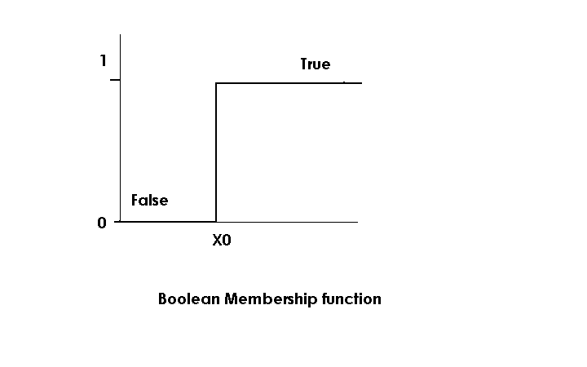
Boolean Logic

Slide 6
Fuzzy Logic
People make smooth continuous distinctions between different states
We recognise an almost infinite number of states
I am cold / quite cold/ very cold / hellishly cold / f***ing freezing
In gaming we want our bots to appear “lifelike”
Analogue not digital

Slide 7
Fuzzy Logic
“Fuzzy logic is a way of presenting problems to a computer akin to the way humans perceive/solve them”
In fuzzy logic everything is a matter of degree
In the real world we use fuzzy logic to interpret rules that are used for:
Control
Trains
Air conditioning
Heating systems
Robots
Video Games (motion control)

Slide 8
Fuzzy Logic
Threat assessment
Enemy force considered on a threat scale
Allow defensive response to be more smooth and less predictable
Classification
Ranking player and NPCs in terms of combat
Weighing up strength, weapon proficiency, number of kills, armour class etc.

Slide 9
Overview
There are three steps in fuzzy inference:
Fuzzification
Crisp input → Fuzzy Input
Fuzzy Rule Application
Fuzzy input → Fuzzy output
Via fuzzy rules
Defuzzification
Fuzzy output → Crisp output

Slide 10
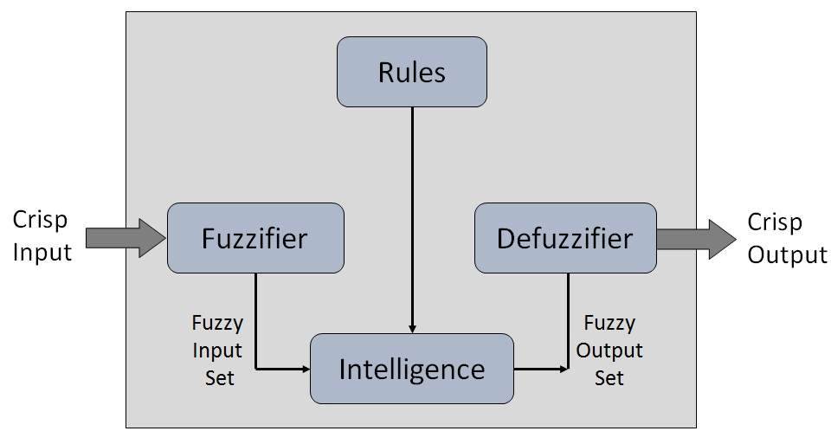
Overview

Slide 11
Overview
How do we define fuzzy input?
Or fuzzy anything?
It all begins with sets!
In boolean logic either you are in a set or you are not
In fuzzy logic you are in a set to a certain degree
0 ➔ not in set
1 ➔ definitely in set
0.5 ➔ half in/half out
etc.

Slide 12
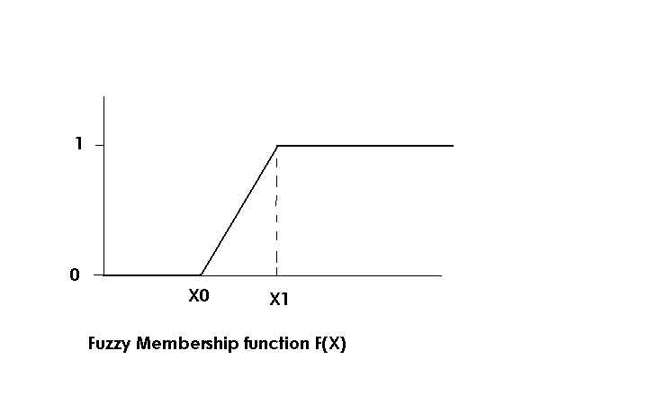
Fuzzy Set Membership

Slide 13
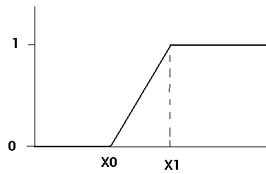
Fuzzy Set Membership
Our set membership function returns a value between 0 and 1
Membership function F(x)=
0 if x <= x0
1 if x >= x1
(x - x0) / (x1 - x0) if x0 < x < x1

Slide 14
Fuzzy Set Membership
F(X) can take different shapes
and we can define functions for them all:
F(X) =
0 if x <= x0 OR x >= x2
1 if x = x1
(x - x0) / (x1 - x0) if x0 < x < x1
(x2 - x) / (x2 - x1) if x1 < x < x2

Slide 15
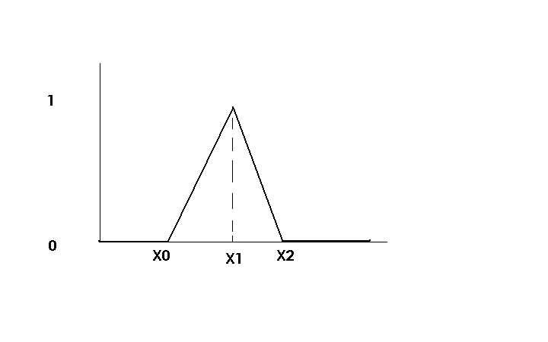
Fuzzy Set Membership
The triangular membership function

Slide 16
Fuzzy Set Membership
F(X) =
0 if x <= x0 or x >= x3
1 if x1 <= x <= x2
(x - x0) / (x1 - x0) if x0 < x < x1
(x3 - x) / (x3 - x2) if x2 < x < x3

Slide 17
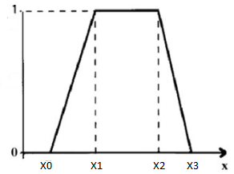
Fuzzy Set Membership
The trapezoid membership function

Slide 18
Fuzzy Set Membership
At the root of fuzzy set theory lies the idea of linguistic variables.
A linguistic variable is a fuzzy variable.
For example, the statement “John is tall” implies that the linguistic variable John takes the linguistic value tall.
What does tall mean to you?

Slide 19
Fuzzy Set Membership
In fuzzy expert systems, linguistic variables are used in fuzzy rules. For example:
IF wind is strong
THEN sailing is good
IF project_duration is long
THEN completion_risk is high
IF speed is slow
THEN stopping_distance is short

Slide 20
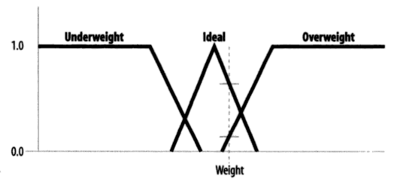
Fuzzy Set Membership
Consider trying to categorise someone’s weight
If we set up our fuzzy sets as below and map their weight (dotted line below), then we can classify them as follows:
Underweight to a degree 0
Ideal to a degree .75
Overweight to a degree .15
We infer that their weight is substantially ideal (to a degree of 75%)

Slide 21
Fuzzy Set Membership
These are all easily coded
and quick to compute
Some practitioners recommend using 7 fuzzy sets to fully define the working range of any input variable
Far left, left, near left, centre, near right, right, far right
These categories can be anything, depending on your game

Slide 22
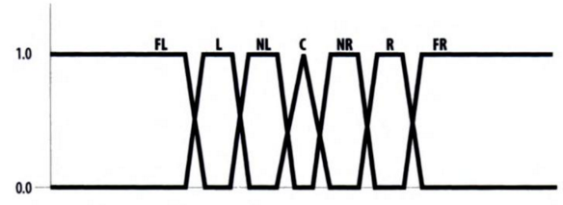
Fuzzy Set Membership
The seven fuzzy sets

Slide 23
Fuzzy Set Membership
Each set should overlap its neighbour by about 25%
Rule of Thumb
We could use other membership functions for greater accuracy or non-linearity
Typical functions that can be used to represent a fuzzy set are gaussian , sigmoid, and PI (bell).

Slide 24
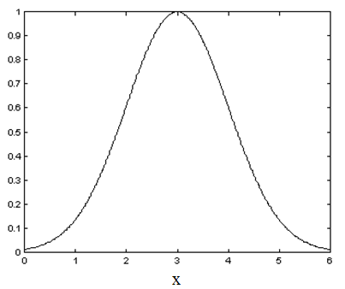
Fuzzy Set Membership
A Gaussian member function
Notes:
Check out https: https://www.youtube.com/watch?v=6YDHBFVIvIs for a domo of a Galton Board and to see a normal distribution in action.
Also //www.mathsisfun.com/data/quincunx-explained.html lets you play with one!

Slide 25
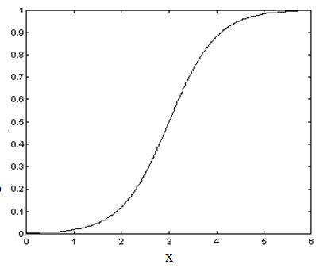
Fuzzy Set Membership
A Sigmoidal member function

Slide 26
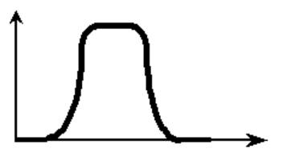
Fuzzy Set Membership
A PI/Bell member function

Slide 27
Fuzzy Set Membership
Generally we do not need the extra accuracy
These functions increase the time of computation. Therefore, in practice, most applications use linear fit functions.
But see later (ANN)

